Slide 1
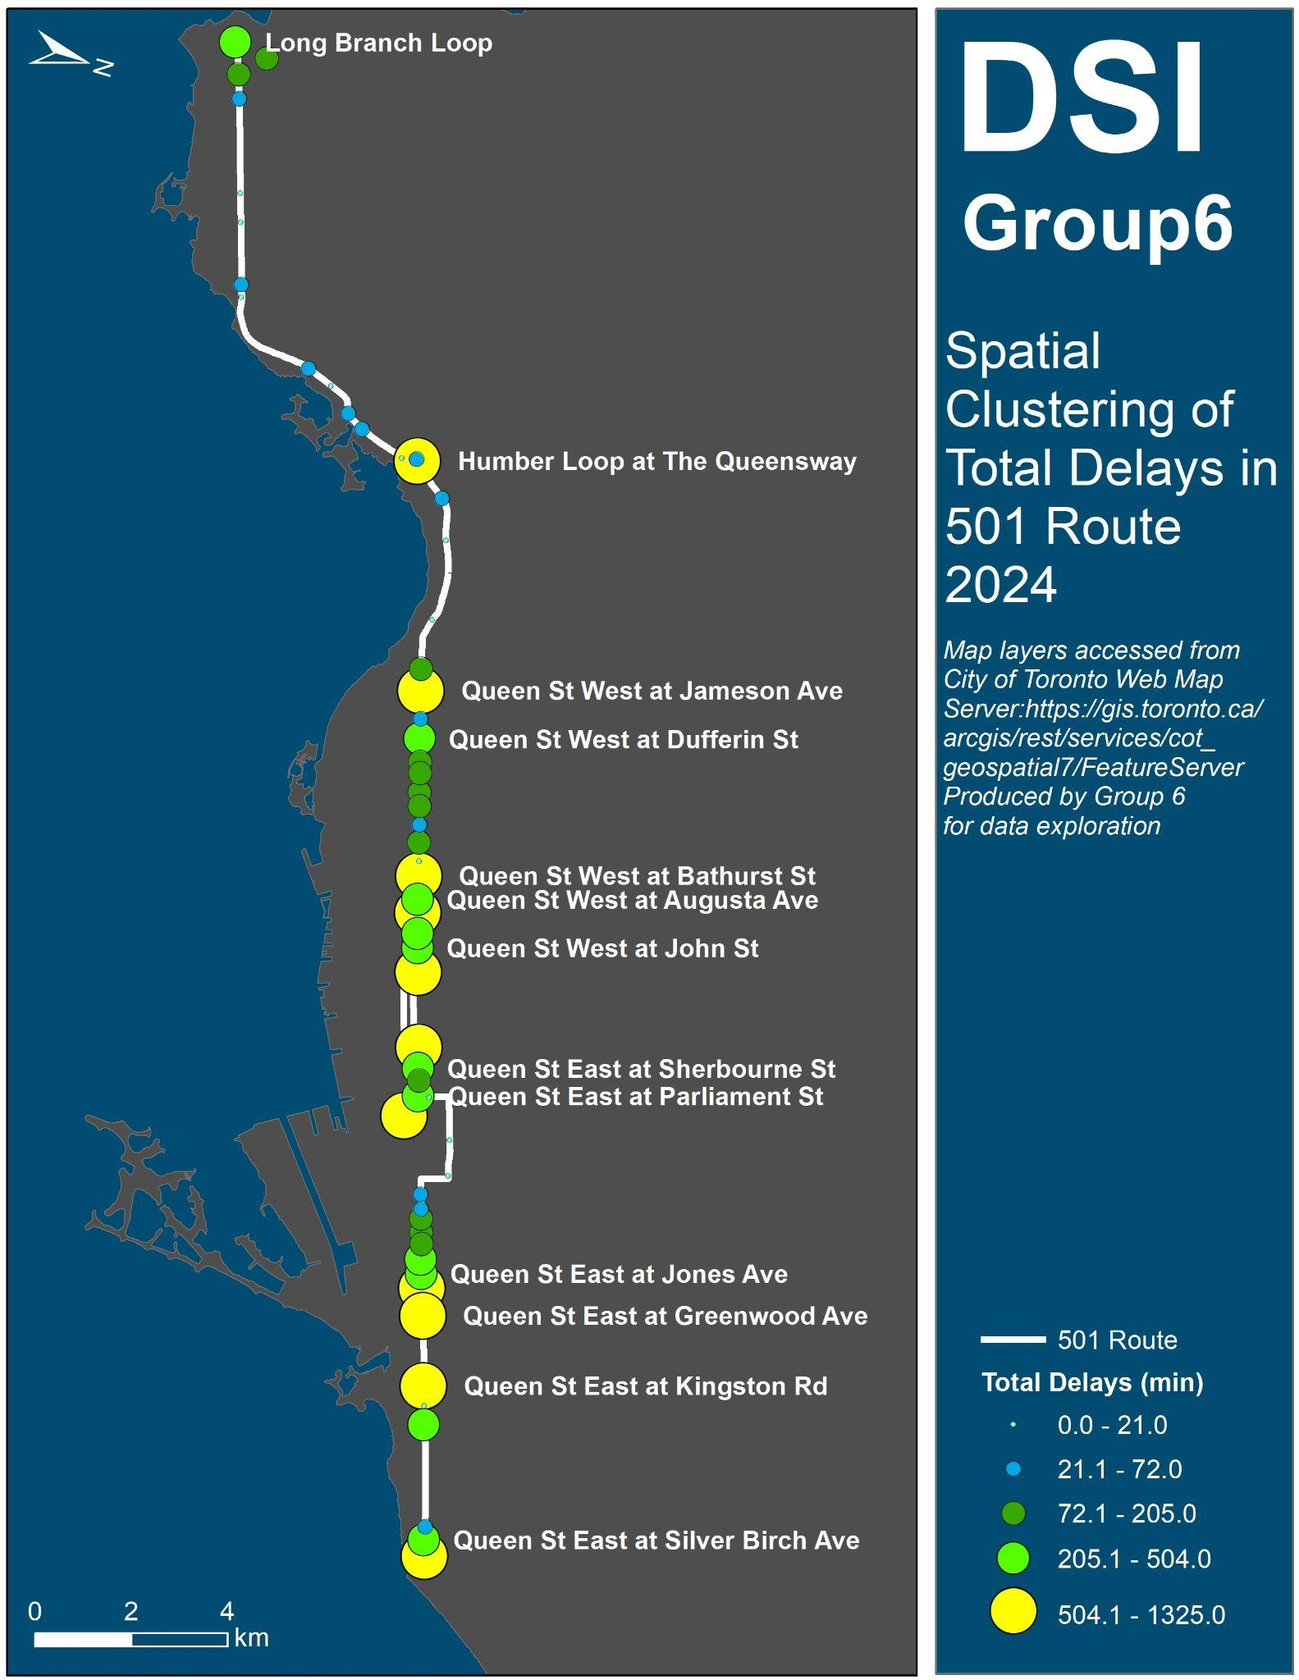

Analyzing TTC Streetcar
Delays in 2024
Team DS6
Chloe Li
Christine Romano
Natasha Mathew
Semiha Demirbas Caglayan
Tanner Ferreira
Data from City of Toronto Open Data on Streetcar Delays: https://open.toronto.ca/dataset/ttc-streetcar-delay-data/
Notes:
Alphabetize the names
NM

Slide 2

Rationale and Goals for the Project
Can we identify the key factors that impact streetcar delay times?
Features recorded by TTC include: Location, Time of Day, Date, Line, Incident Type, Minute Gap, Vehicle, Direction
External source: climate.weather.gc.ca
Examined 2024 data: most recent dataset
Stakeholders include:
  TTC Business Strategy & Insights Teams
  TTC Operations, Planning, & Data Teams
  TTC Communications Team
  TTC HR Team
  TTC Users
Notes:
CL - maybe add TTC Operations, Planning, and Data Teams: build predictive models and use the insights to optimize streetcar schedules?
NM
Stakeholders include:
Business Strategy & Insights Team: Leverage results to inform new route planning or network design
TTC Operations, Planning, and Data Teams: Use insights to optimize streetcar schedules.
TTC Communications Team: Communicate accurate delay information
TTC HR: Apply findings to staffing and hiring decisions.
TTC Users: Plan their commutes based on knowledge of likely delays.

Slide 3
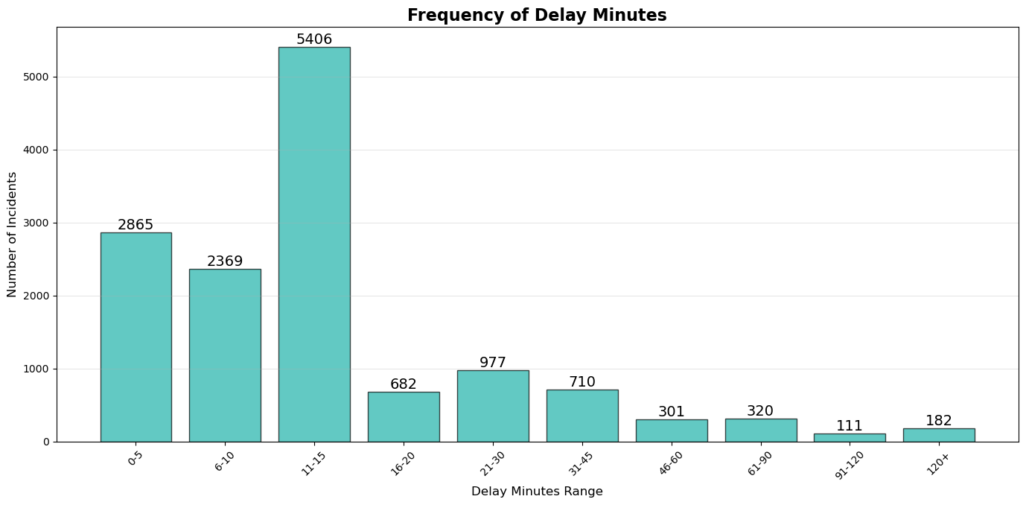




Findings from Exploratory Analyses
Data is messy, especially Location
  Numerous inconsistencies that had to be cleaned manually.
  2104 unique locations before cleaning, 1573 after cleaning.
  Location data removed from regression analyses
Visualization provided more insights
than regression / classification
for this dataset!
Skewed dataset
  Mean = 16 minutes
  Median = 10 minutes
Notes:
Can also show R^2 values here…..
CR and NM
Average minute delayed showed very skewed data because of some outliers - most delays were between 0 and 15 minutes
Mean is 16 minutes
Important consideration for analysis

Slide 4
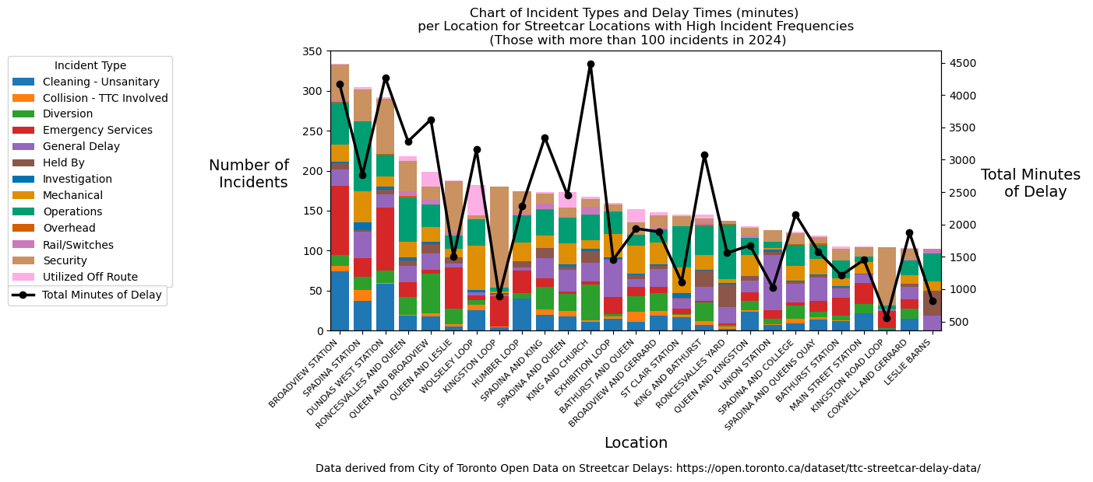
Certain Locations Were “Delay Hotspots”
Just under 2% of locations (27) accounted for 32.2% of delay incidents and 26.4% of delay time in 2024.

Slide 5
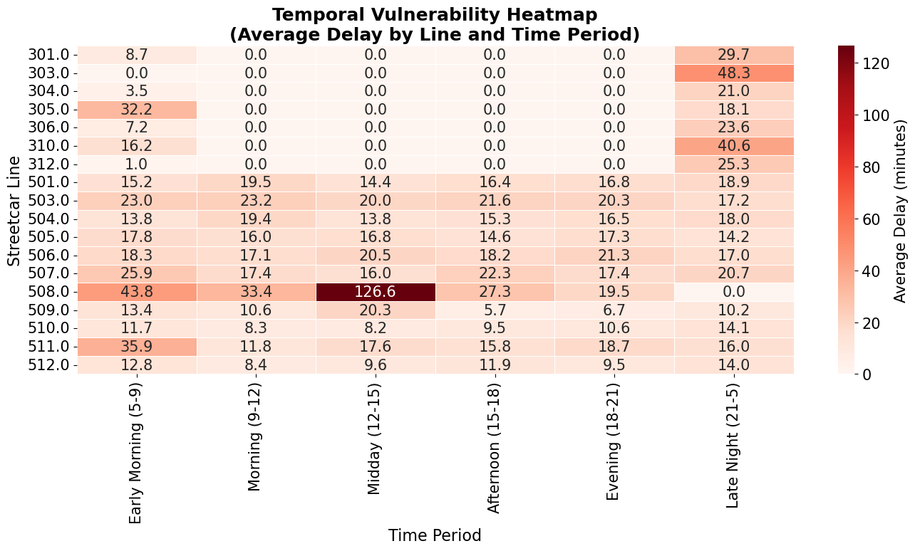
Some lines and times of day were more prone to delays
Line 508 accumulated long delays midday.
Delays more likely late night and early morning.
Notes:
CR
Action for Semiha: include all the streetcar lines - I don’t see 501 or 504. Change legend to horizontal.
Decision: use this visual

Slide 6
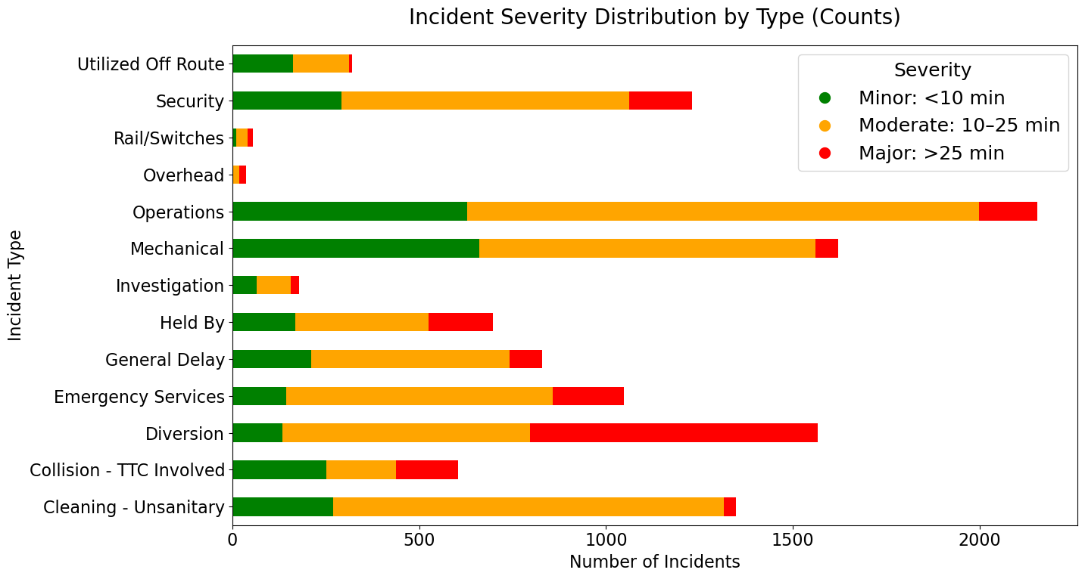
Certain types of incidents created more frequent and longer delays
Majority of incidents only caused minor or moderate delays
Diversions likely to cause long delays
Highest frequency categories are within TTC’s control
Notes:
NM
Majority of issues were minor or moderate (between 1 to 25 min)
Diversions likely to cause long delays (> 25 min)
Operations issues cause the most incidents
The 3 highest frequency of incidents are in categories that are largely within the TTC’s control (operations, mechanical & diversions)

Slide 7
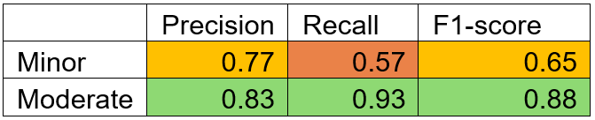
Model Methods and Results
Regression
Early analysis showed (‘Min_Gap’) consistently correlated with ‘Min Delay’, which is expected because it depends on ‘Min Delay”
Weak correlations when ‘Min_Gap’ is excluded.
Classification: Random Forest
Key features:
1. Hour
2. Temperature
3. Week
4. Day
5. Month
Overall model accuracy = 0.82
Regressor Model | R² when Min_Gap Feature Included | R² when Min_Gap Feature Excluded
Linear Regression | 0.965 | 0.074
Ridge Regression | 0.965 | 0.074
Lasso Regression | 0.963 | 0.079
Random Forest | 0.960 | -0.050
K Neighbors Regressor | 0.915 | -0.057
XG Boost Regressor | 0.970 | -0.335
Notes:
Regression - CR
Classification - NM
Random forest classification: good at handling noisy and mixed-type data with many independent variables
Merged weather data - find out temp & precipitation would be good classifiers
Removed minute delay and location outliers
Key features:
Hour
Temperature
Subsets of date columns
Overall model accuracy - not bad - better at classifying moderate delays (larger subset of the data) than minor delays
Look at incident types separately - features may be different
Earlier, I mentioned that we shied away from using regression models to predict delay times. Here’s why! We got good R2 values when we included “min gap” as a predictor, but this feature depends on “min delay” and should not be used. When we rely on other features as predictors, our R2 values plummet. We decided not to pursue regression with this dataset.

Slide 8
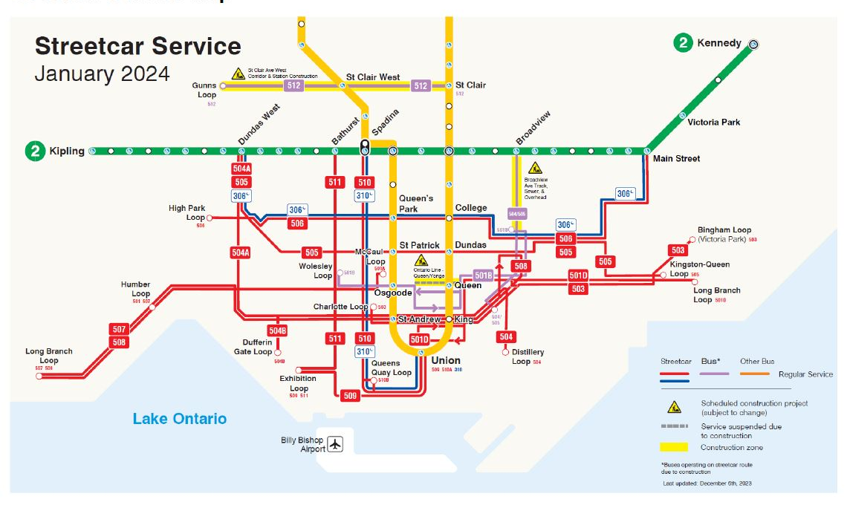
Recommendations to TTC:
Standardize the way location data is collected.
Potential to make a large impact with few resources by focusing on high-incident locations and lines.
The 3 highest frequency of incidents are in categories that are largely within the TTC’s control (operations, mechanical & diversions).
Notes:
CR

Slide 9
END

